Slide 1
AirBnB SQL Project

Slide 2
Project Questions
What are the 10 most reviewed listings?
What are the top 5 most expensive neighbourhoods?
Are any hosts fully booked for March 2025 and which hosts are the busiest in March 2025?
Who are the hosts with the least listings?
Identify some hosts which may benefit from a new cleaning service provider

Slide 3
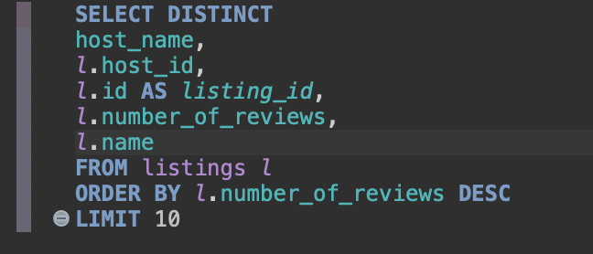
Question 1: Code

Slide 4
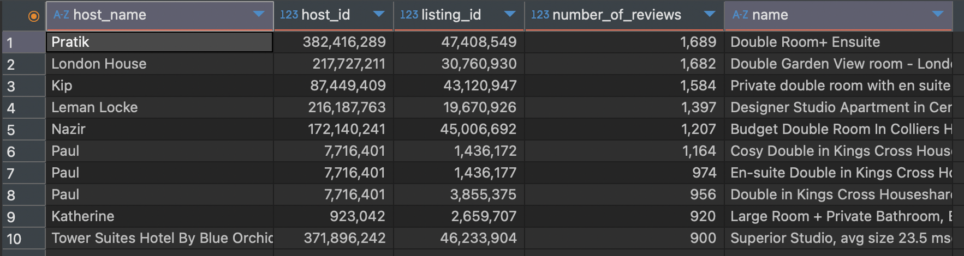
Question 1: Output

Slide 5
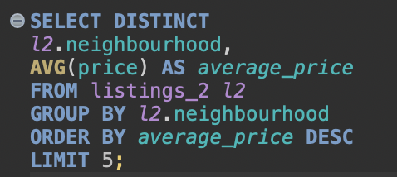
Question 2: Code

Slide 6
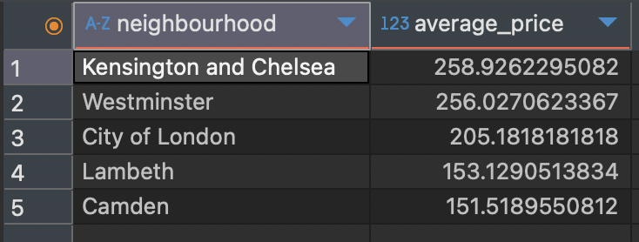
Question 2: Output

Slide 7
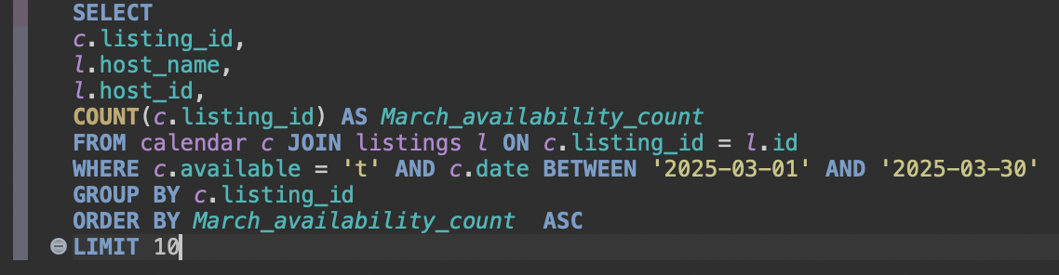
Question 3: Code

Slide 8
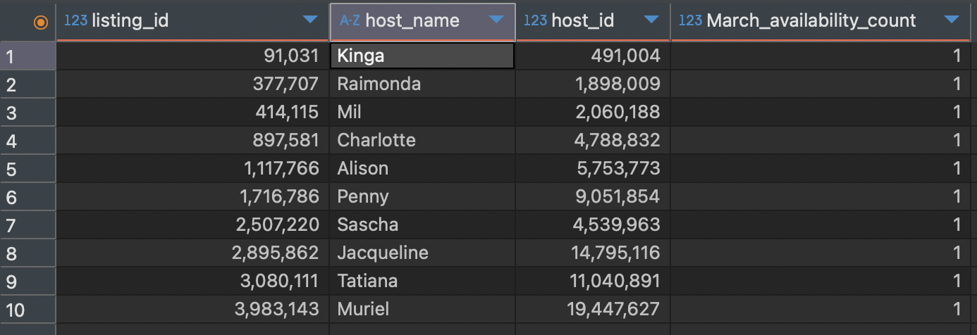
Question 3: Output

Slide 9
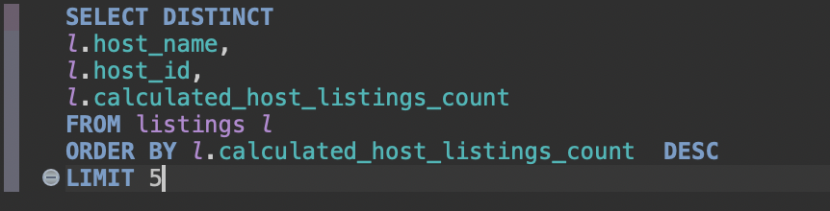
Question 4: Code

Slide 10
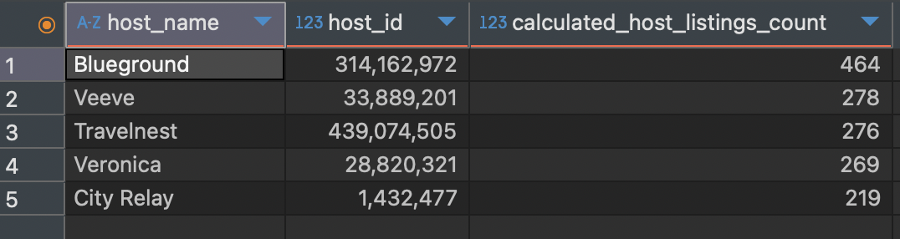
Question 4: Output

Slide 11
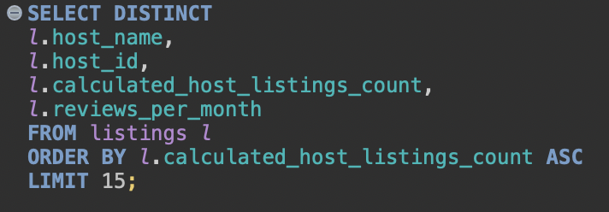
Question 5: Code

Slide 12
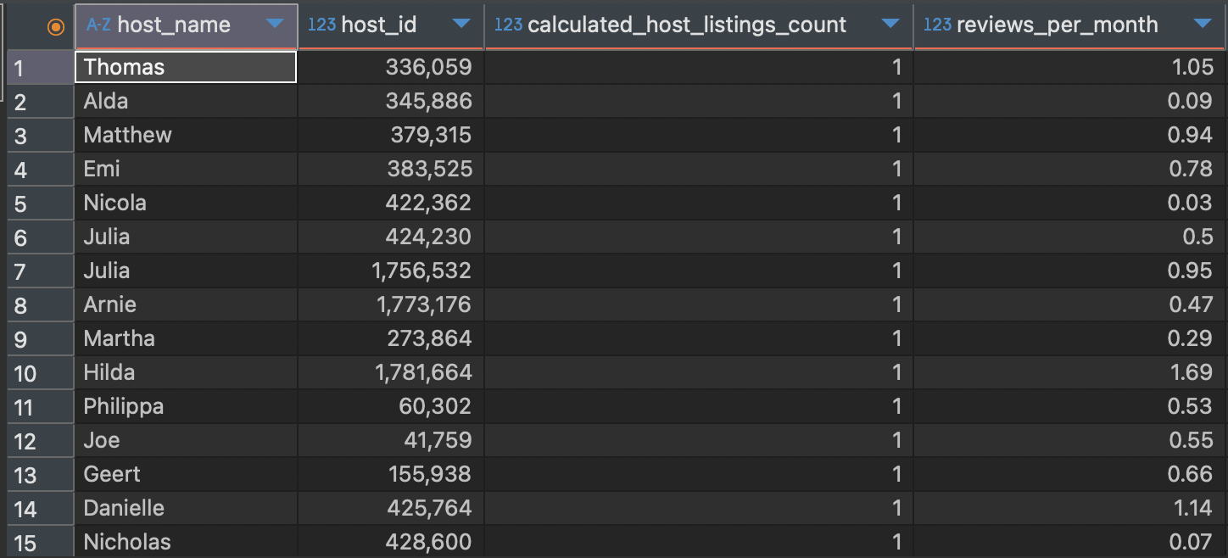
Question 5: Output

